Slide 1


Oceanic and atmospheric controls on decadal melt variability around the Amundsen Sea
Joren Janzing
Supervisors:
Kaitlin Naughten, Pierre Dutrieux, Roderik van de Wal

Slide 2
Content
Introduction
Method
Preliminary Results and Discussion - Oceanic patterns - Atmospheric patterns - 1940s event
Conclusion

Slide 3
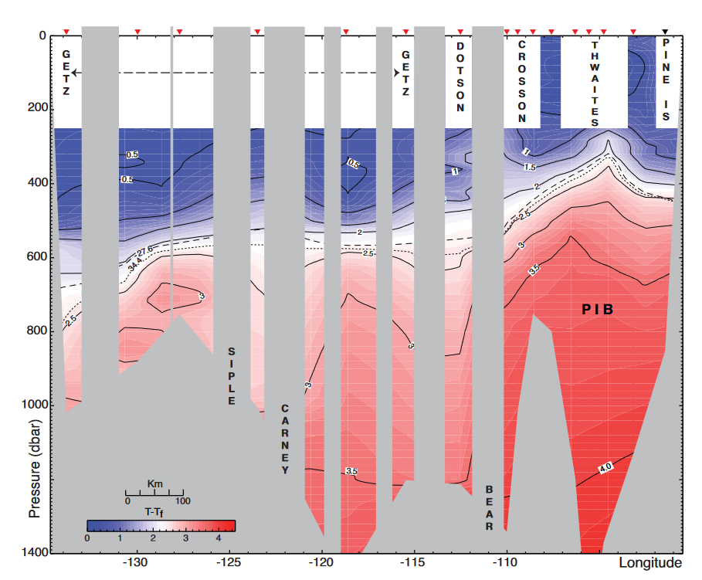
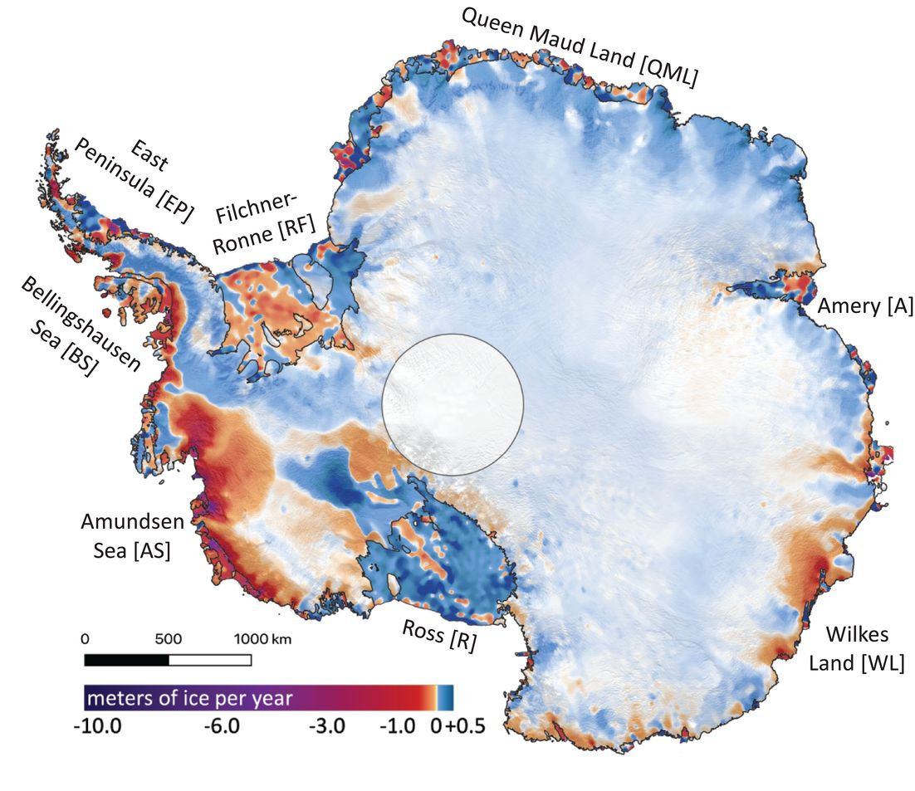
Introduction
Source: Jacobs et al., 2012
Source: Smith et al., 2020
High melt is related to the presence of warm Circumpolar Deep Water (CDW) on the shelf.

Slide 4
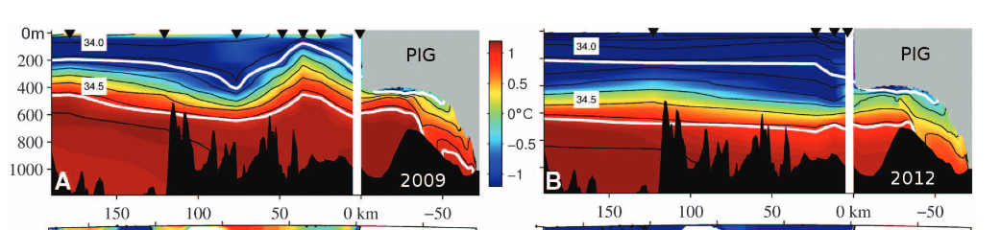
Introduction
2009
2012
Source: Dutrieux et al., 2014
There are fluctuations in amount of CDW on the shelf.

Slide 5
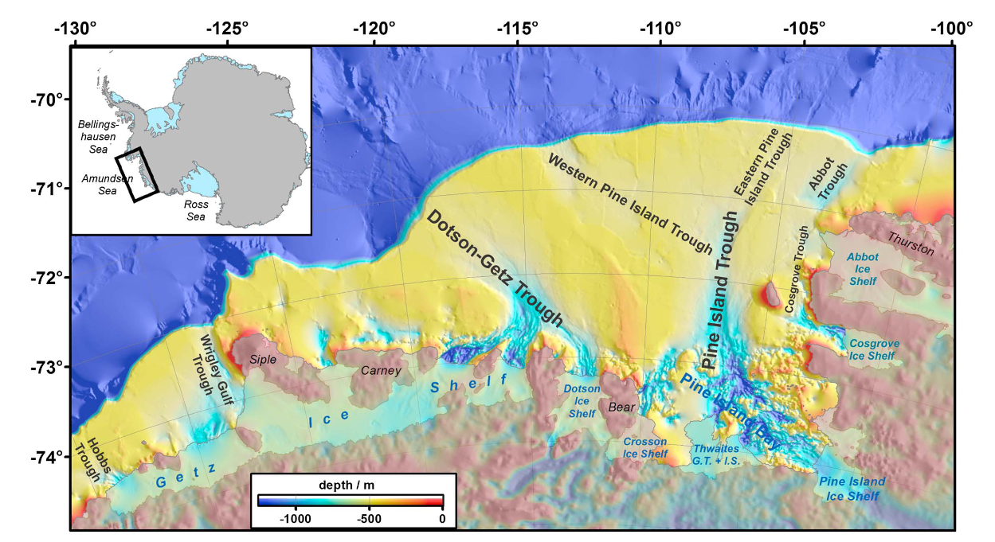
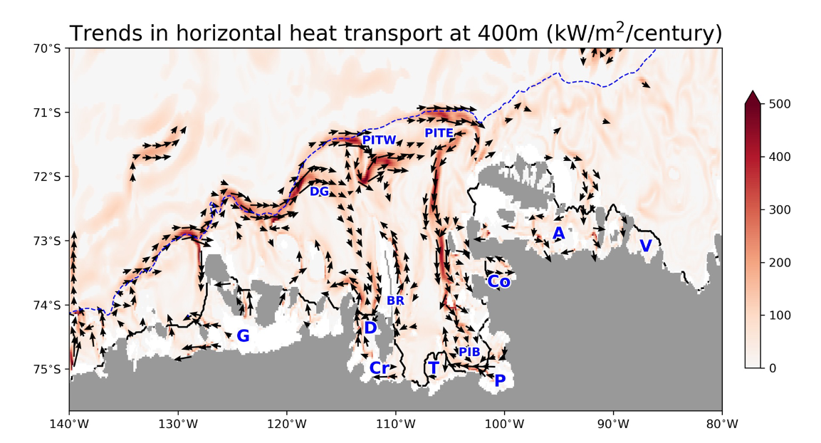
Introduction
The continental shelf is intersected by multiple seabed troughs.
Source: Turner et al., 2017
Source: Naughten et al., 2022

Slide 6
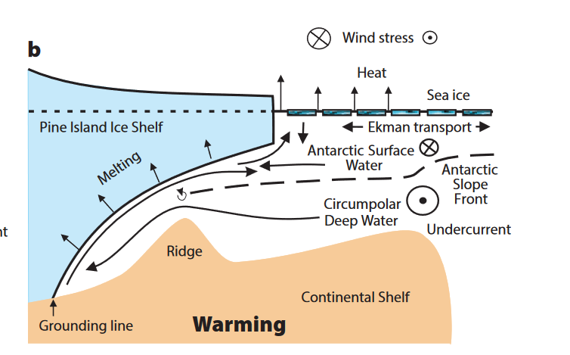
Introduction
Zonal Wind Stress (and curl)
Shelf Break Undercurrent
Heat Advection on Shelf
Source: Jenkins et al, 2016
Glacial Melt
“An eastward wind anomaly leads to a stronger shelf break current, which leads to more heat advection on the shelf and therefore to more glacial melt.”

Slide 7
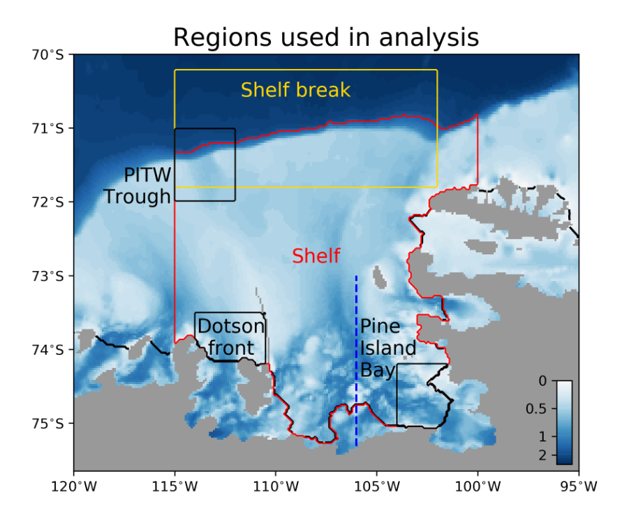
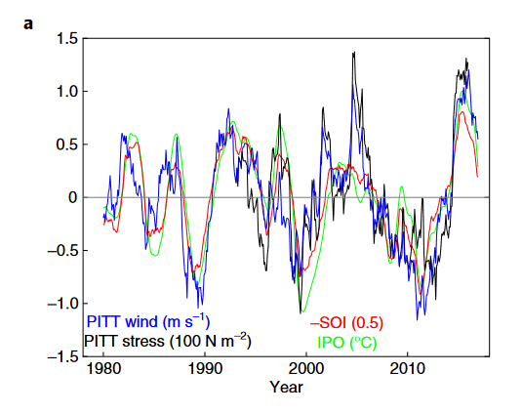
Introduction
Tropical variability (IPO)
Zonal Wind Stress (and curl)
Shelf Break Undercurrent
Source: Holland et al., 2019
Heat Advection on Shelf
Source: Naughten et al., 2022
Clear correlation between winds at shelf break and IPO.
The idea is that these winds drive an undercurrent along the shelf break, which bring warm water on the shelf.
Glacial Melt

Slide 8
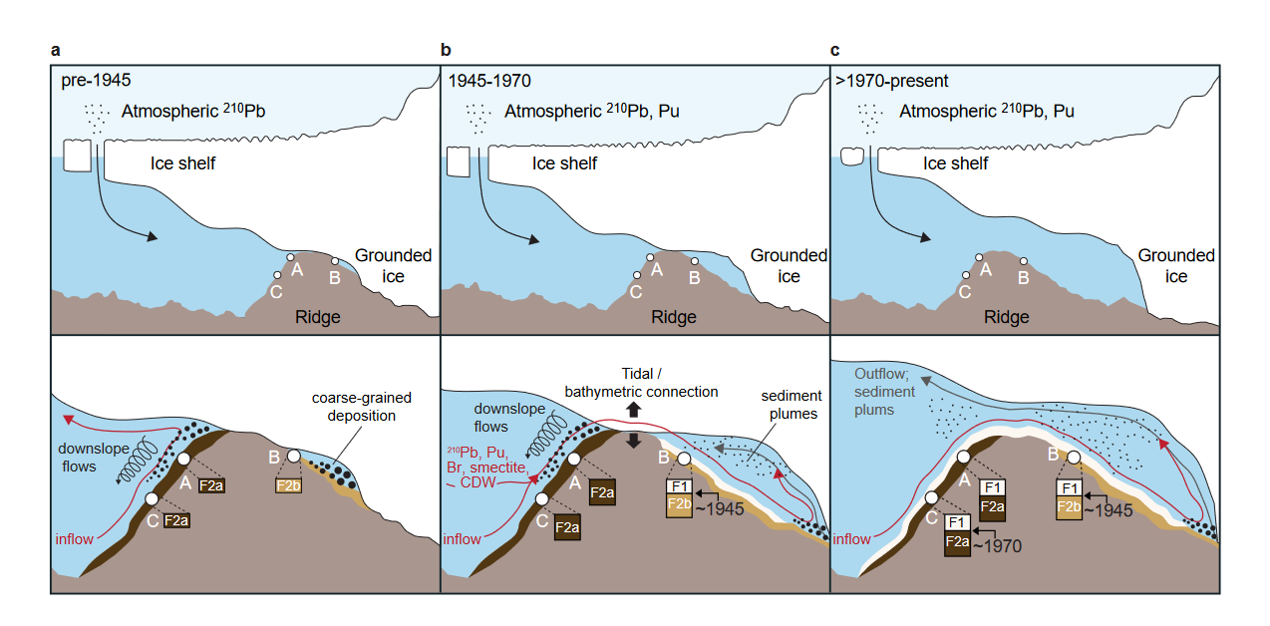
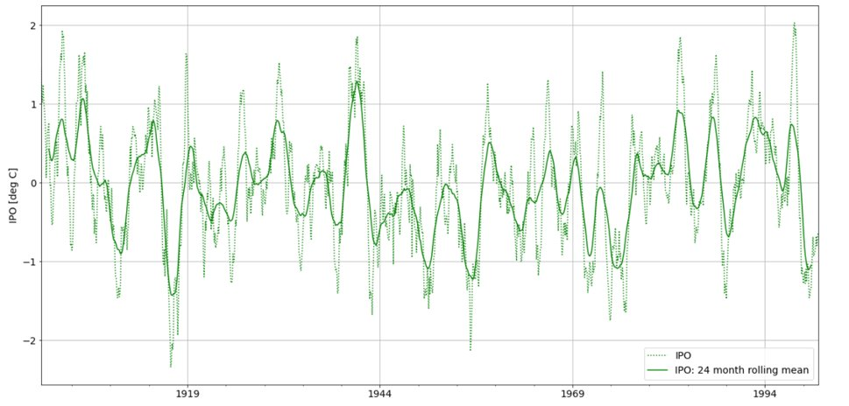
Introduction
Smith et al., 2017

Slide 9
Introduction
Limited observations → Ensemble
Naughten et al., 2022: analysis of trend.
Does this also work for decadal variability?
Tropical variability (IPO)
Zonal Wind Stress (and curl)
Shelf Break Undercurrent
Heat Advection on Shelf
Glacial Melt
Source: Jenkins et al, 2016

Slide 10
Method
Output of MITgcm from Naughten et al., 2022:
Amundsen Sea, with fixed ice sheet geometry
Boundaries fixed at present day climatology.
Forcing from PACE ensemble:
CESM
20 ensemble members
Constrained historical tropical variability in Pacific
Historical GHG concentrations
Period of interest: 1920-2013
Source: Naughten et al., 2022

Slide 11
Method: Main tool Correlation maps
Detrended by 25 year running mean and remove seasonal cycle.
Correlate each point in space with a time series
Look at different lags and look for maximum absolute correlation.
Do this for each member and take the average.
Note: mean of correlation in ensemble members ≠ correlation of ensemble mean!
In individual ensemble members, there is random internal variability.
This is cancelled out in the ensemble mean.

Slide 12
Proposed Mechanism
Tropical variability (IPO)
Zonal Wind Stress (and curl)
Shelf Break Undercurrent
Heat Advection on Shelf
Glacial Melt

Slide 13
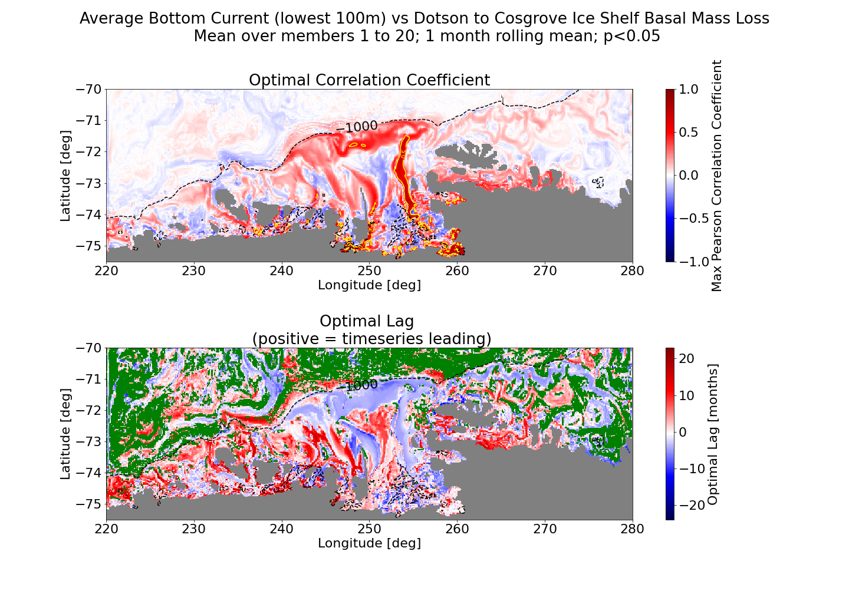
Results: oceanic patterns
High correlation between melt and velocity in the seabed troughs
Flow in troughs leads the melt

Slide 14
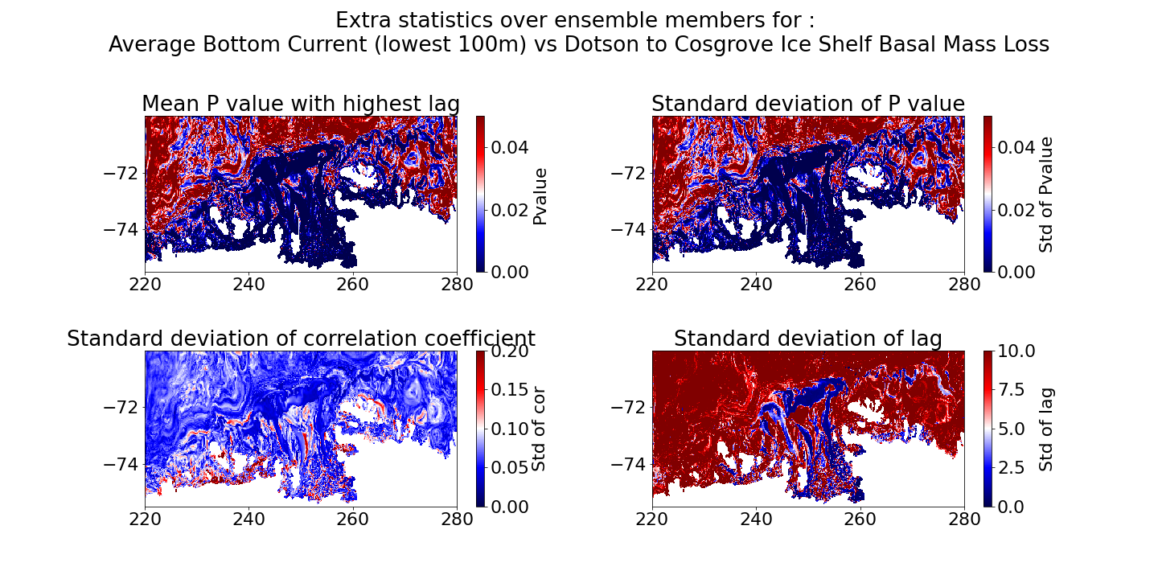

Slide 15
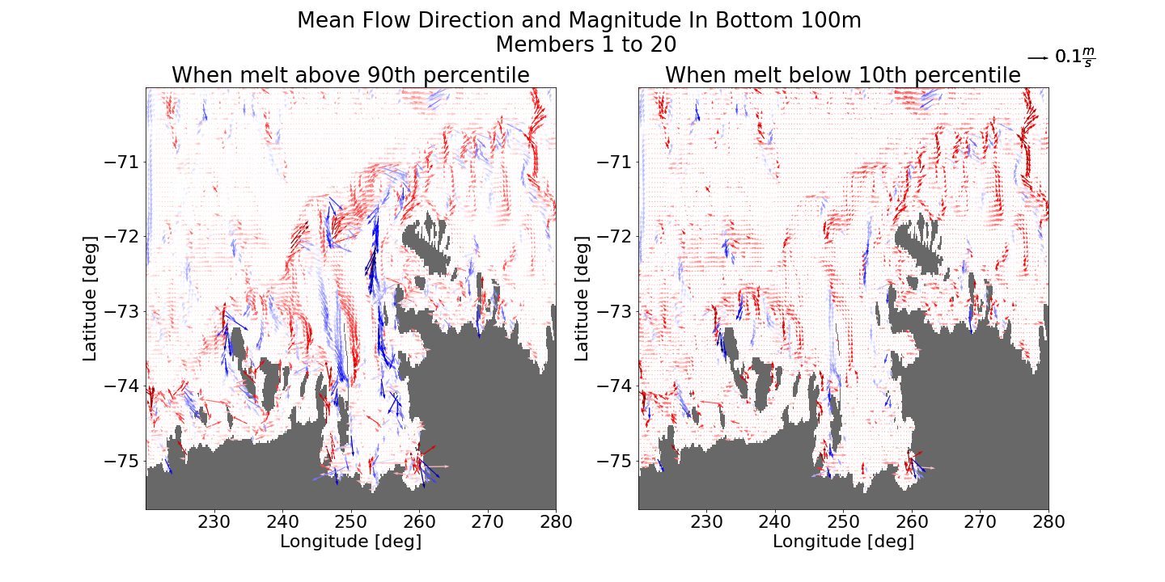
The flow is southward in the trough during high melt, whereas the flow comes to a standstill during low melt.
Flow in troughs leads the melt

Slide 16
Source: Jenkins et al, 2016

Slide 17
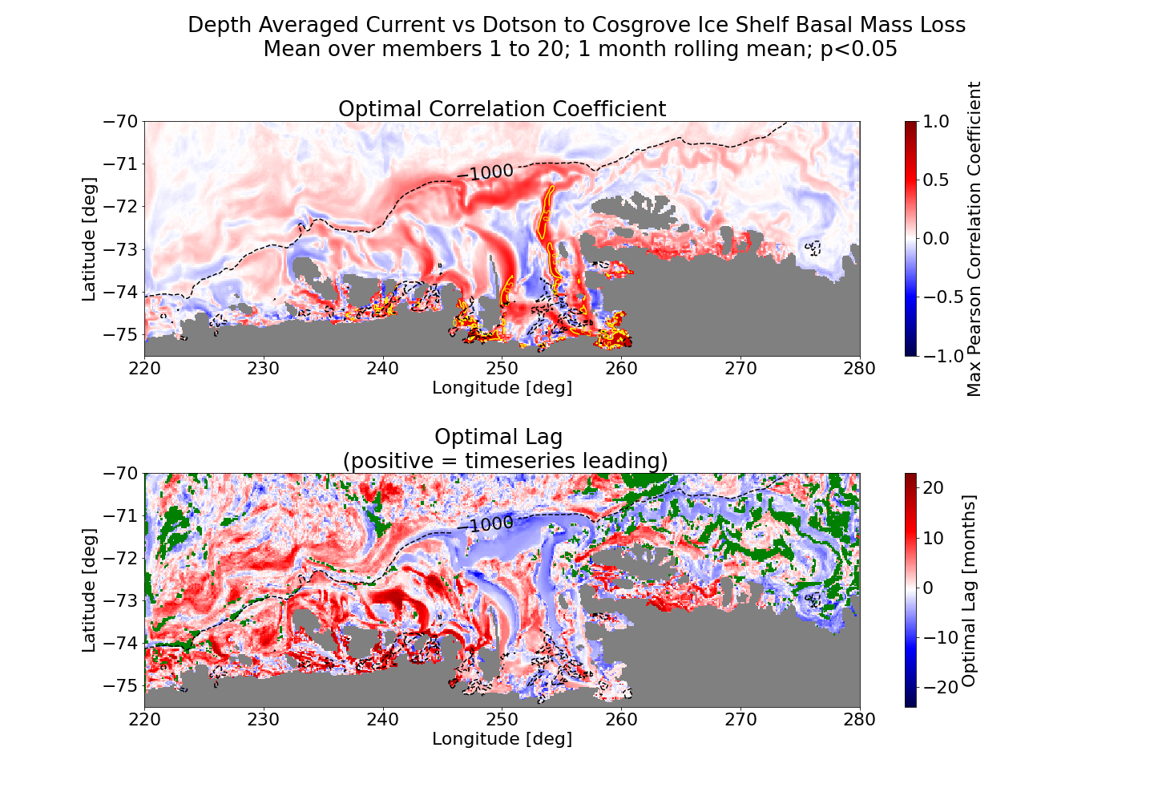
Results: oceanic patterns
Barotropic flow shows roughly the same pattern as the bottom current

Slide 18
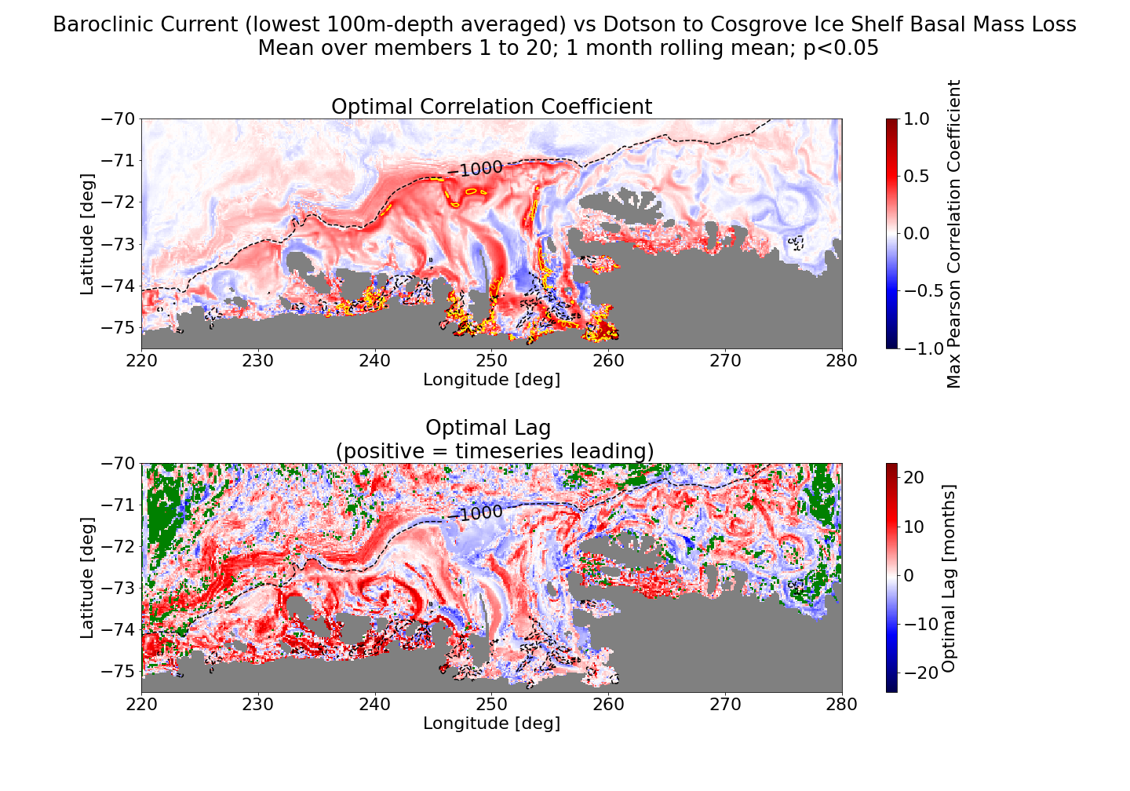
Results: oceanic patterns
Baroclinic flow shows high correlation in West Pine Island Trough, but less in the main trough.

Slide 19
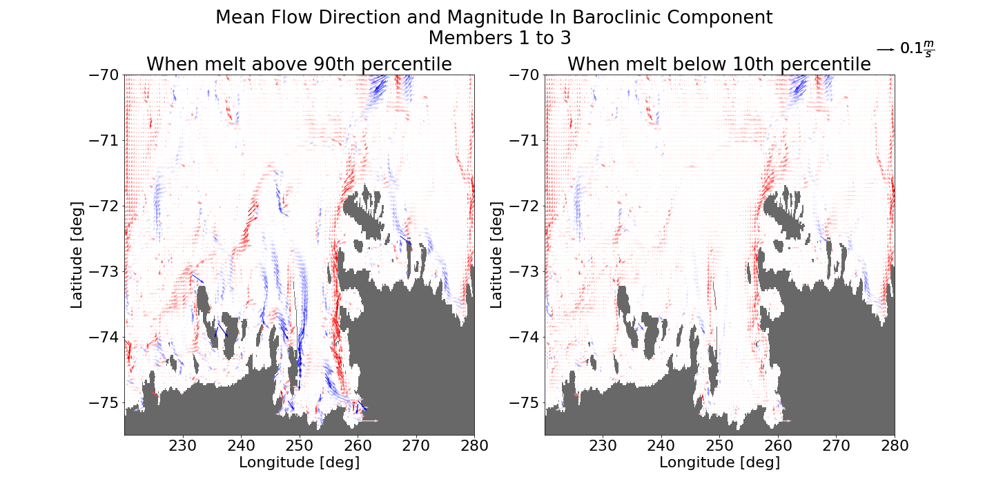

Slide 20
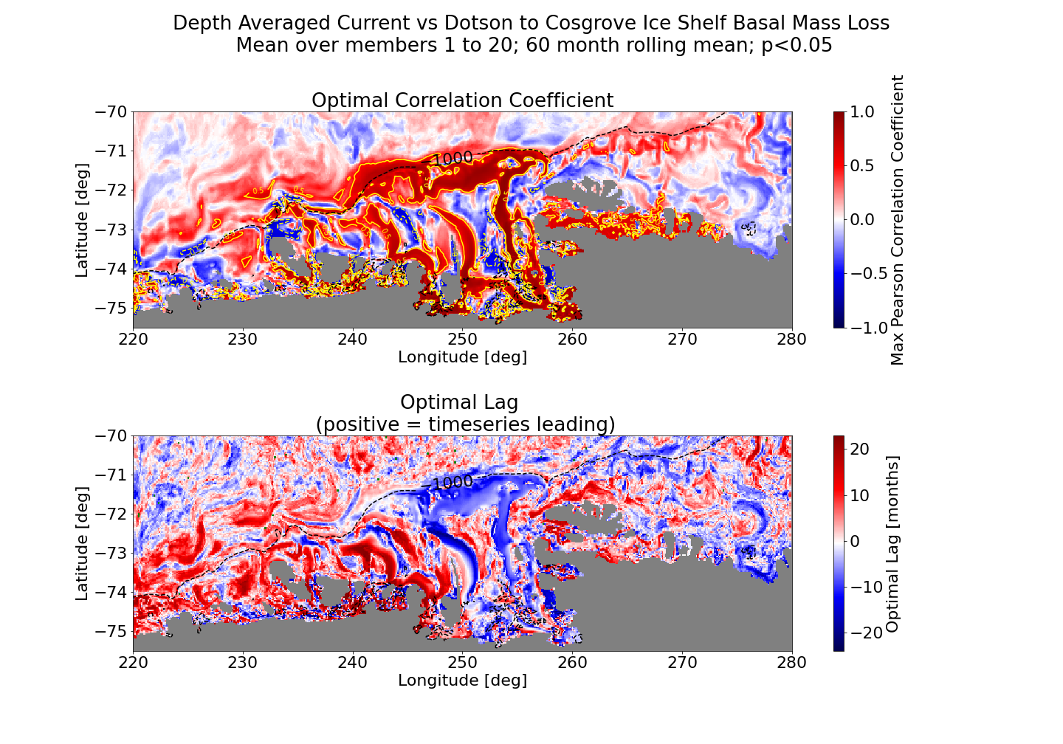
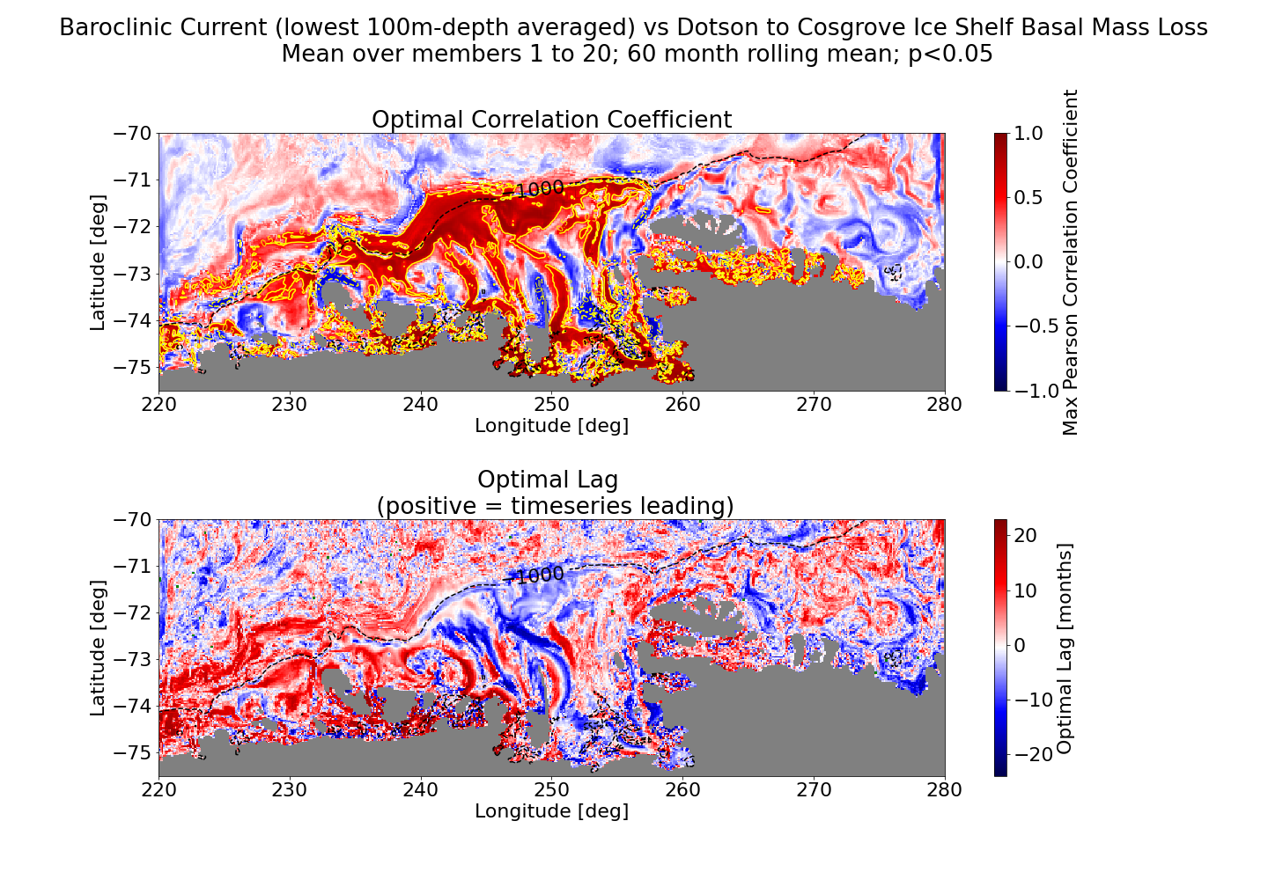
Results: oceanic patterns
When applying a 5yr running mean, patterns are highlighted but stay the same.

Slide 21
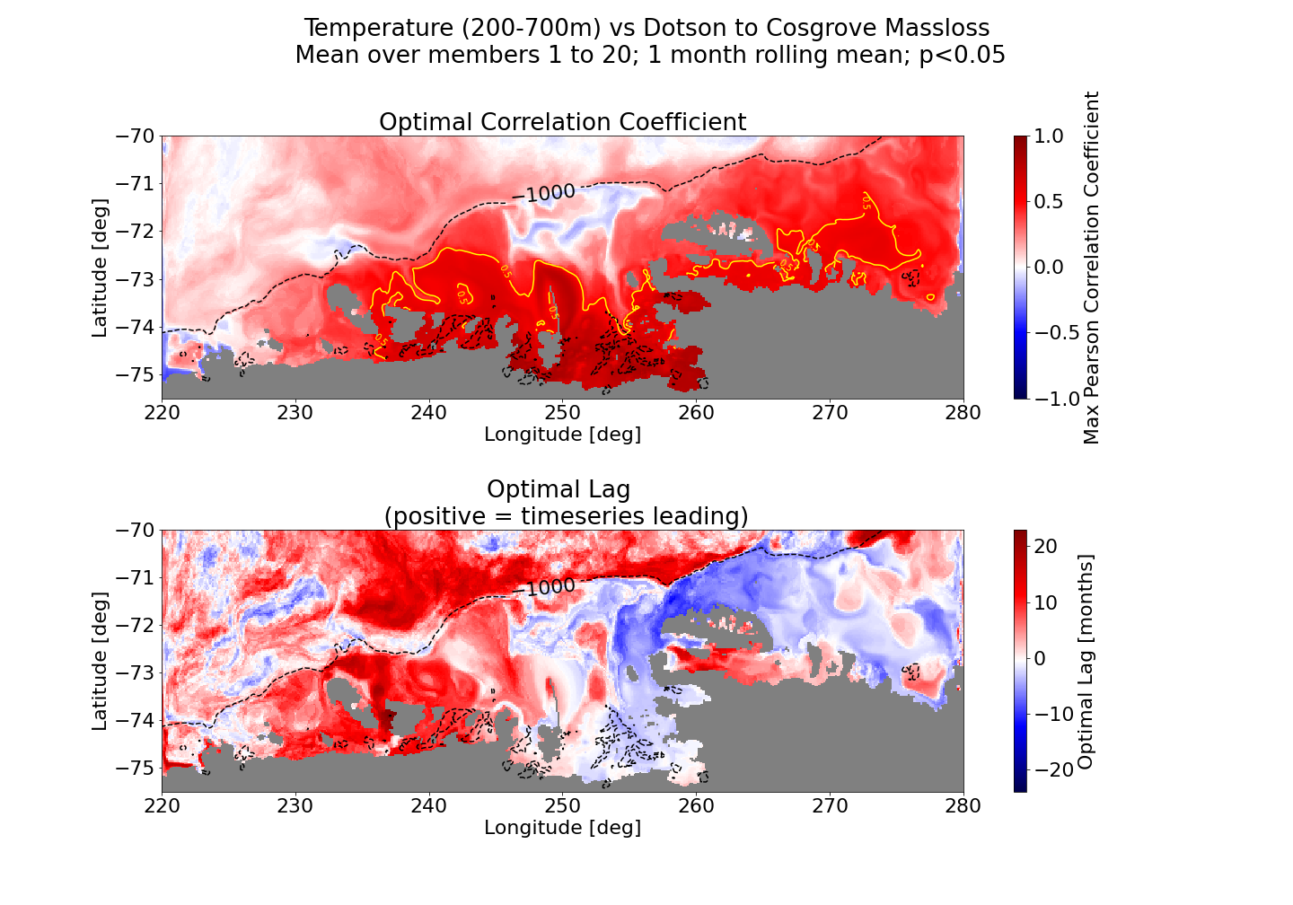
Results: oceanic patterns
Temperature anomaly close to the coast important.
Troughs is not clearly visible.
Temperature anomaly circulates the basin in a clockwise pattern.

Slide 22
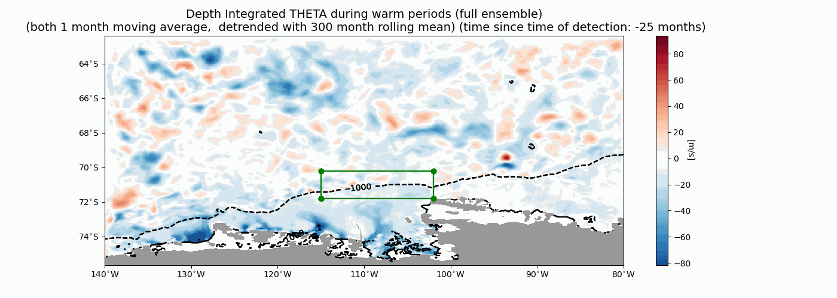

Slide 23
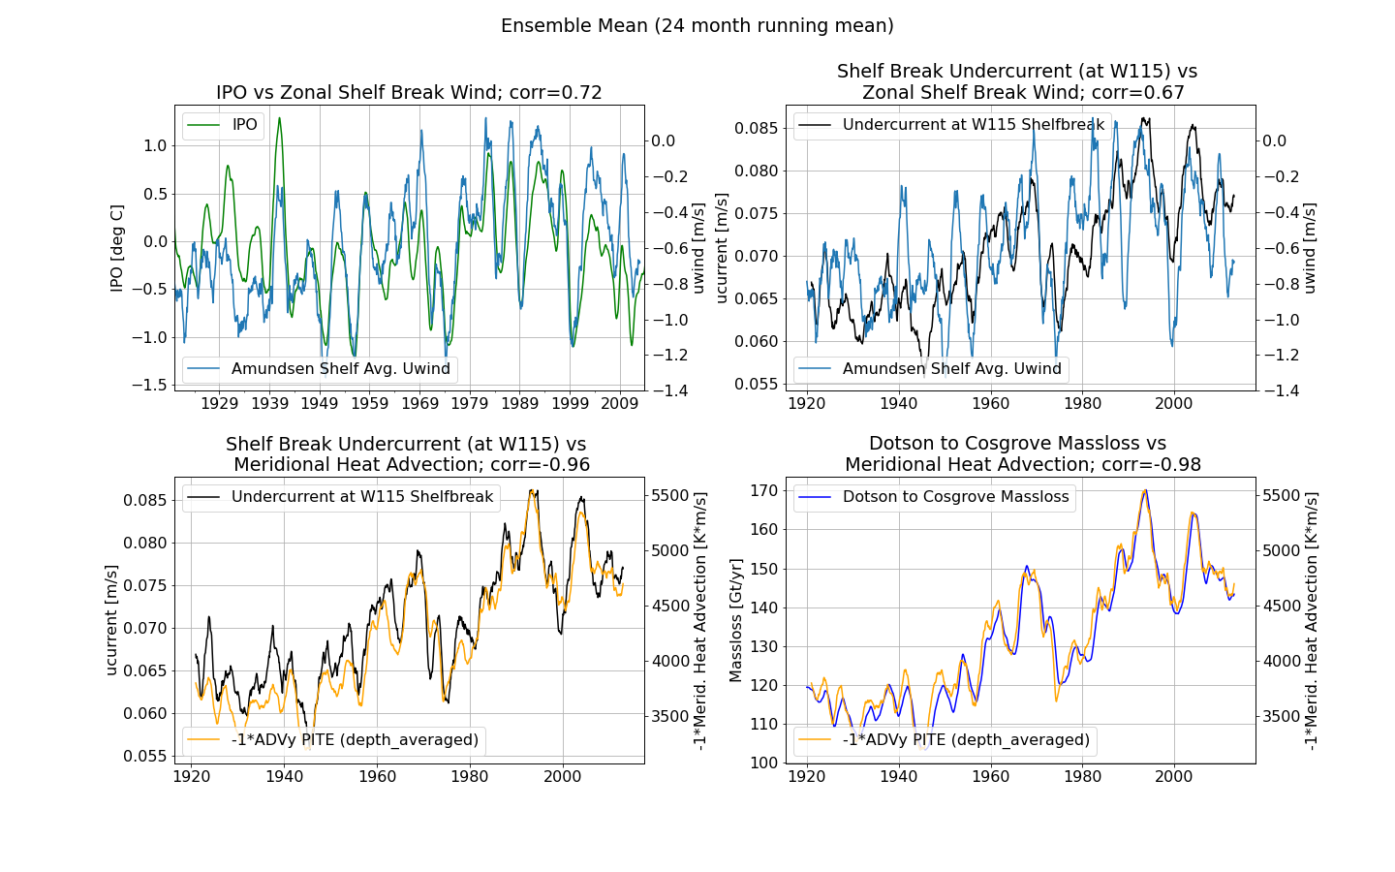
Subconclusion: Oceanic Patterns
Tropical variability (IPO)
Flow velocity in the troughs correlates very strongly with the variations in melt.
The ‘baroclinic’ component is important along the shelf break, but less in the main Pine Island Trough.
Zonal Wind Stress (and curl)
Shelf Break Undercurrent
Heat Advection on Shelf
Glacial Melt

Slide 24
Proposed Mechanism
Tropical variability (IPO)
Zonal Wind Stress (and curl)
Shelf Break Undercurrent
Heat Advection on Shelf
Glacial Melt

Slide 25
In the ensemble mean, connections are quite good! (although weak response in 1940s!)

Slide 26
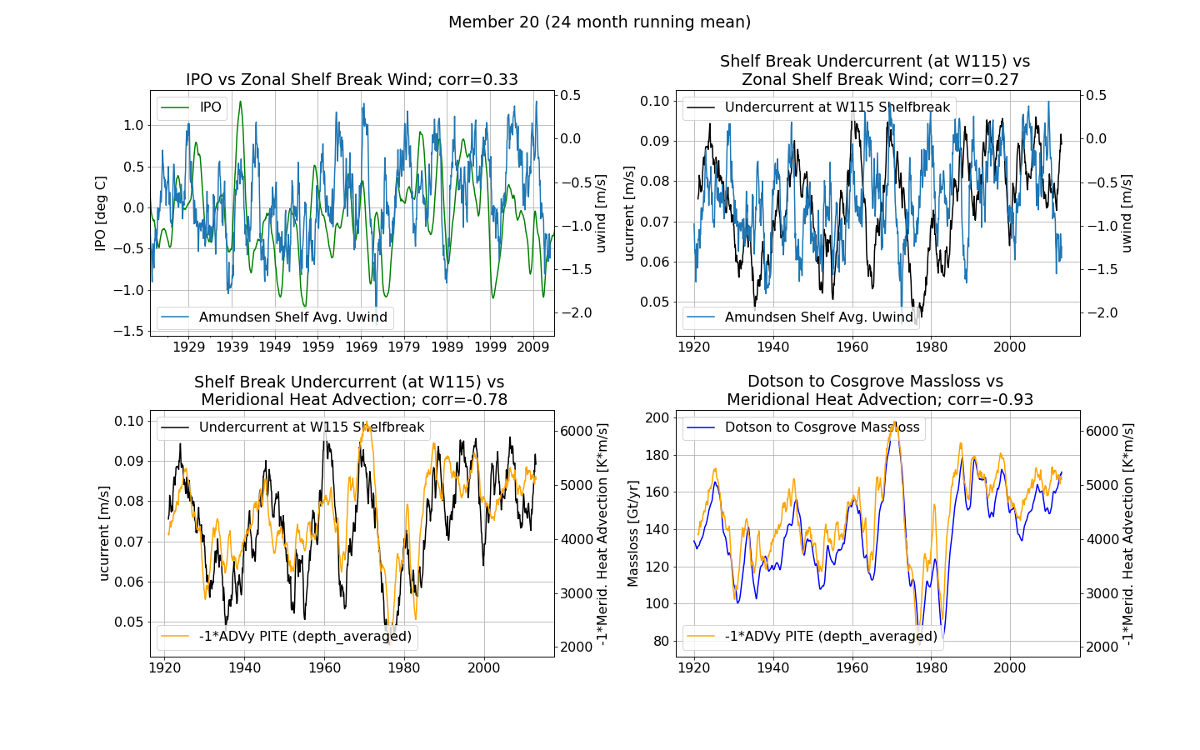
…but in individual members the connection between IPO, wind and shelf break current are weak.

Slide 27
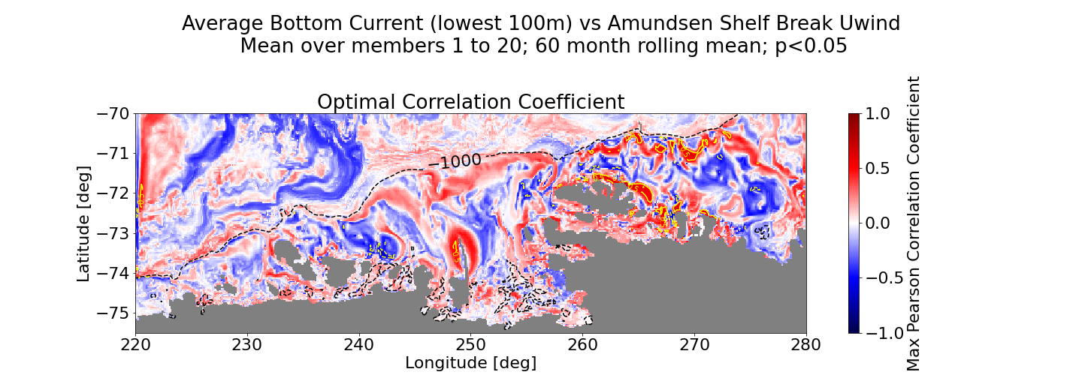
Results: forcing
PITE zonal wind does correlate with the flow, but shows a different spatial pattern: the highest correlation with flow in along the shelf break and in the east of the basin, less in the seabed troughs

Slide 28
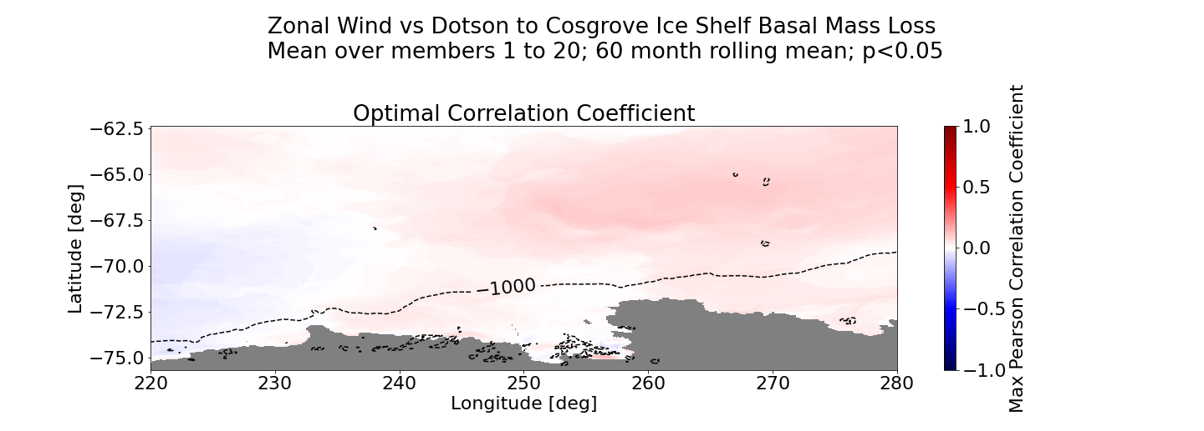
Results: forcing
Also when looking at the wind at other locations, the correlation is low

Slide 29
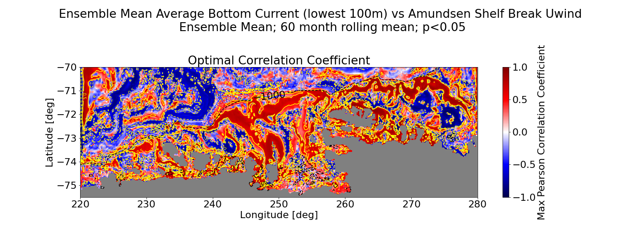
Results: forcing
Seabed troughs light up more when looking at the ensemble mean.

Slide 30
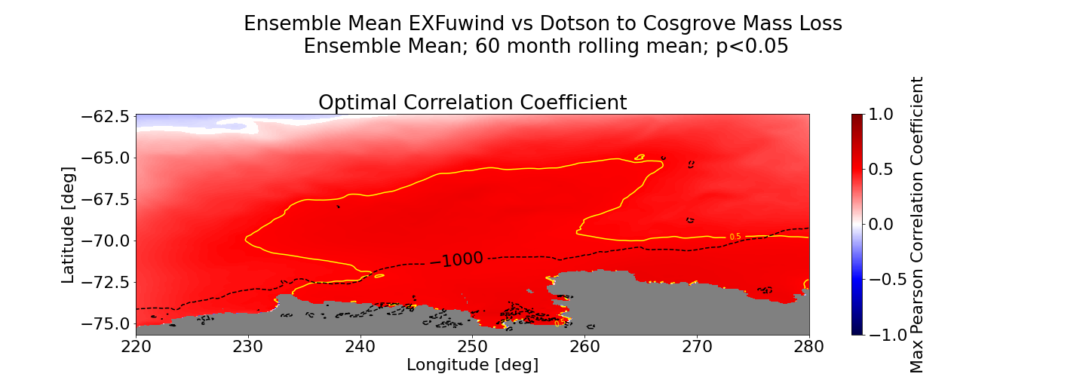
Results: forcing
For the ensemble mean, there is actually a large region that correlates with melt.

Slide 31
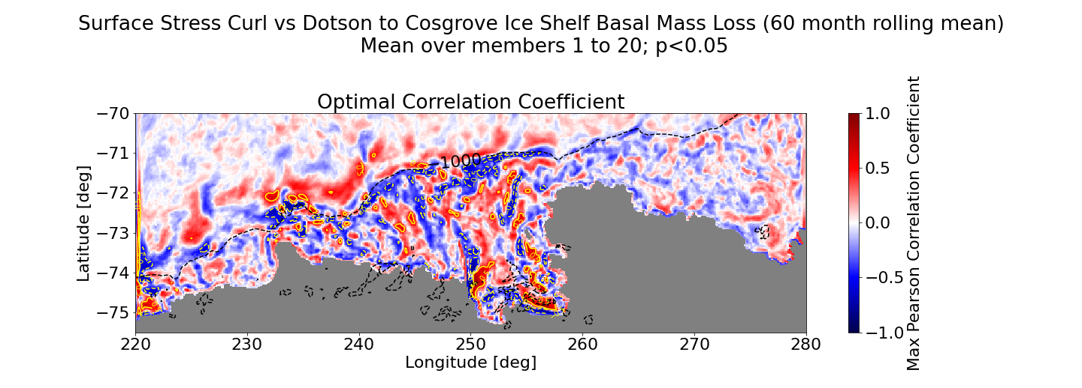
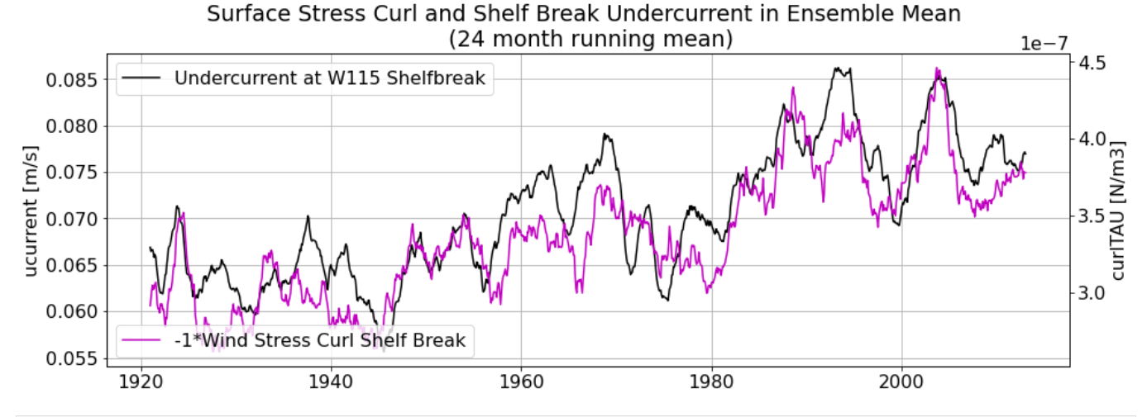

Slide 32
Subconclusion: Atmospheric Patterns
Tropical variability (IPO)
Melt does not correlate very strongly with the zonal wind velocity.
But correlations are much better in the ensemble mean: response might be obscured by internal variability.
Potentially surface stress curl could be the driver.
Zonal Wind Stress (and curl)
Shelf Break Undercurrent
Heat Advection on Shelf
Glacial Melt

Slide 33
What about the 1940s?

Slide 34
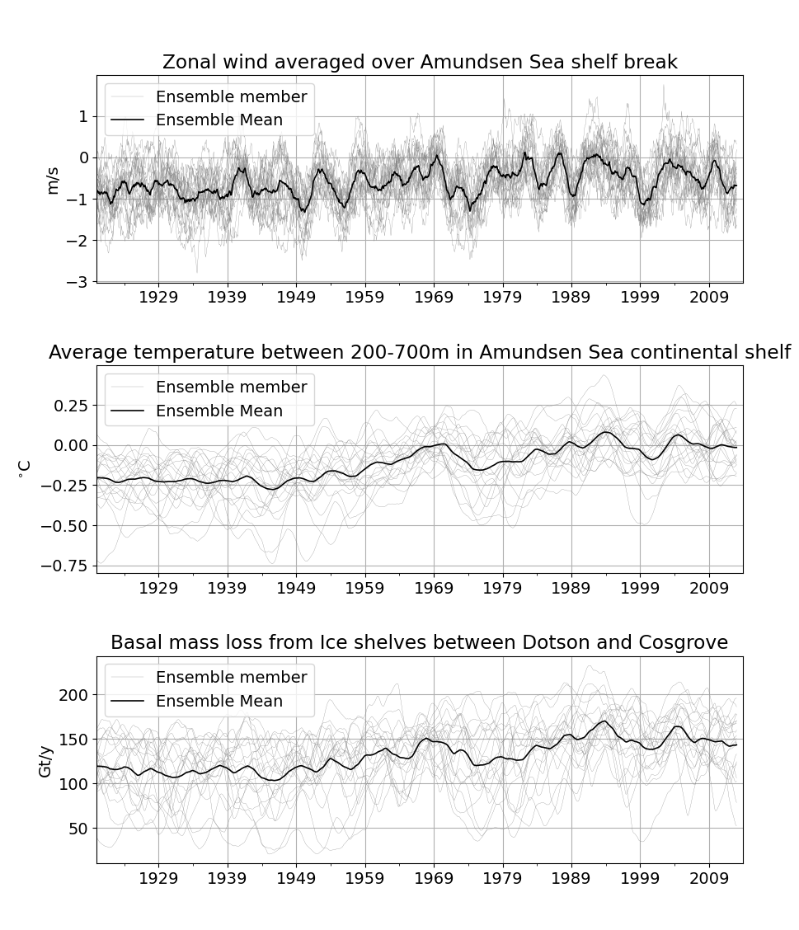
Results: forcing
1940s shows a strong wind response in the ensemble mean….
…but the melt response is much weaker.

Slide 35
Possible reasons for a weak 1940s response
Maybe the wind response to the 1940s ENSO event is not that strong?

Slide 38
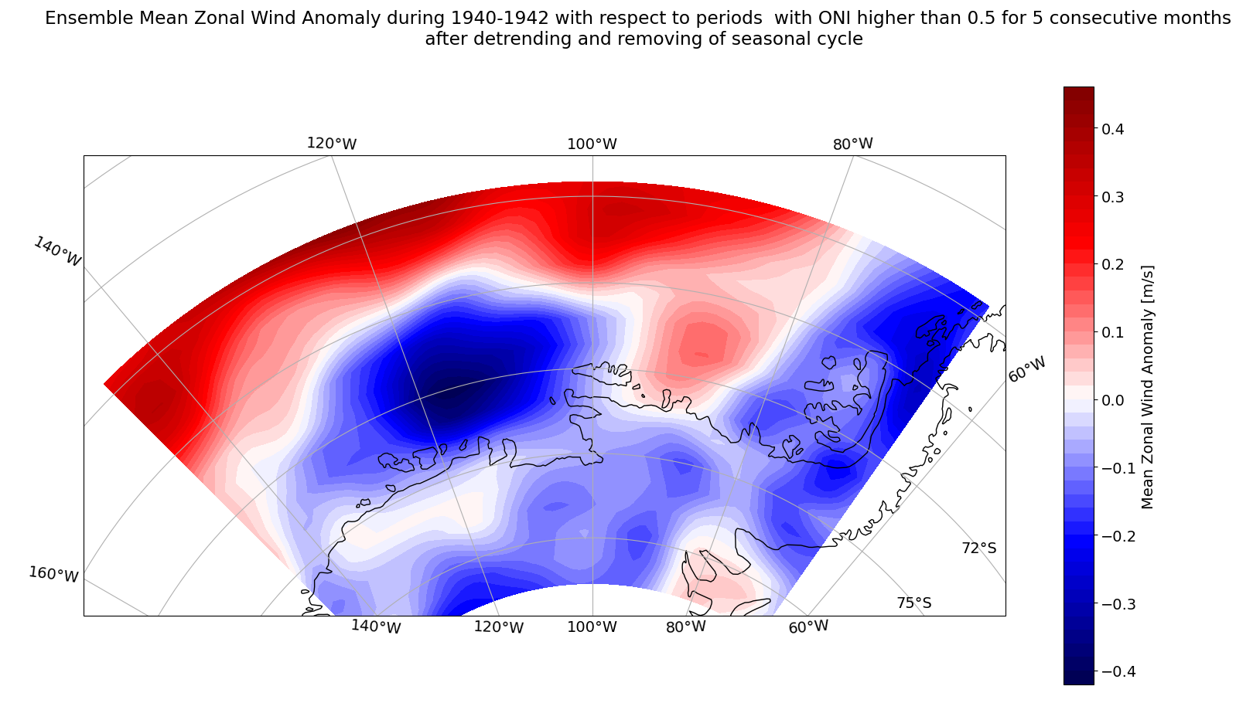

Slide 39
Possible reasons for a weak 1940s response
Maybe the wind response to the 1940s ENSO event is not that strong?
Maybe the connection between the wind and the flow is not direct and simple?

Slide 41
Possible reasons for a weak 1940s response
Maybe the wind response to the 1940s ENSO event is not that strong?
Maybe the connection between the wind and the flow is not direct?
Maybe other processes are influencing this?

Slide 42
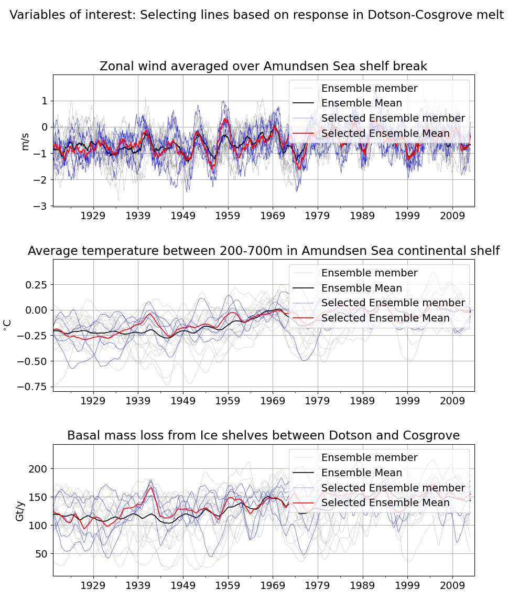
Results: forcing
There are however individual members that do show a response.

Slide 43
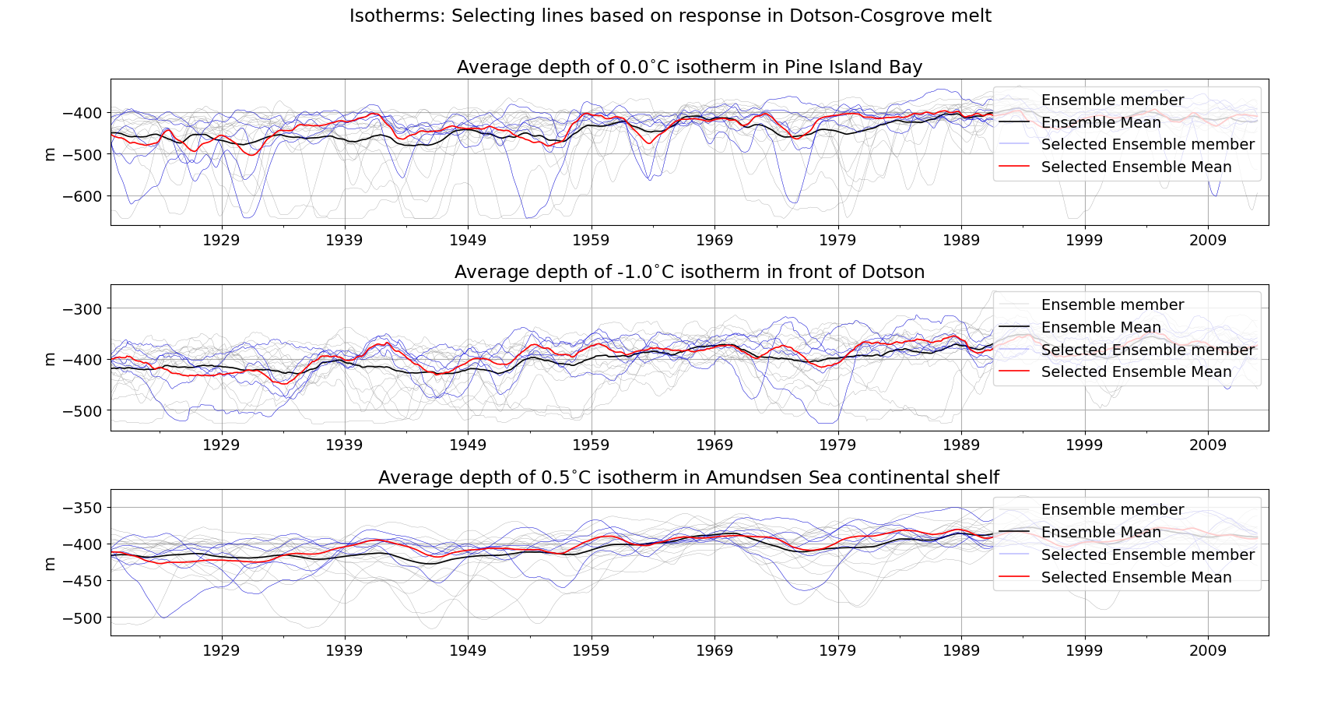
What do they have in common?
Convection?

Slide 44
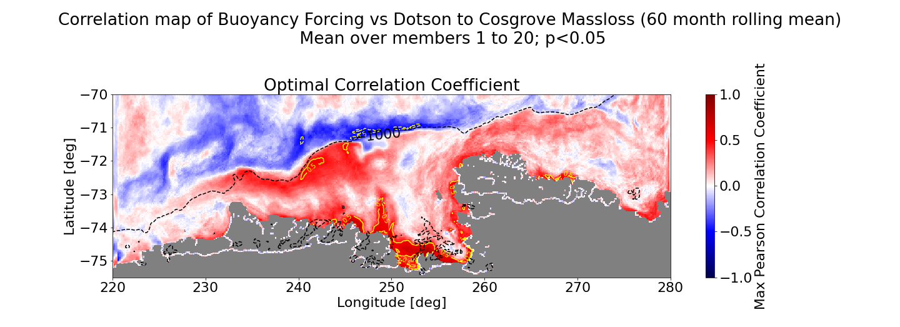
Results: forcing
Buoyancy forcing: coastal processes could play a role…

Slide 45
Conclusions
Strong connection between flow in troughs and melt
Connection of melt with zonal wind, and thus IPO, weaker than expected.
However, it is stronger in the ensemble mean, suggesting that internal variability influence this wind-flow connection.
The weak response in the 1940s could be caused by: - Response in wind was maybe not that strong? - Connection wind and melt is not that simple. - Convection could be ‘masking it’

Slide 46
Outlook
Possible plans for the future: - What is the difference in the forcing for members that do show a strong response in the 1940s?
- New model run to study the effect of ice shelf geometry with a protruded grounding line.

Slide 47
References
Dutrieux, P., De Rydt, J., Jenkins, A., Holland, P. R., Ha, H. K., Lee, S. H., ... & Schröder, M. (2014). Strong sensitivity of Pine Island ice-shelf melting to climatic variability. Science, 343(6167), 174-178.
Holland, P. R., Bracegirdle, T. J., Dutrieux, P., Jenkins, A., & Steig, E. J. (2019). West Antarctic ice loss influenced by internal climate variability and anthropogenic forcing. Nature Geoscience, 12(9), 718-724.
Jacobs, S., Jenkins, A., Hellmer, H., Giulivi, C., Nitsche, F., Huber, B., & Guerrero, R. (2012). The Amundsen Sea and the Antarctic ice sheet. Oceanography, 25(3), 154-163.
Jenkins, A., Dutrieux, P., Jacobs, S., Steig, E. J., Gudmundsson, G. H., Smith, J., & Heywood, K. J. (2016). Decadal ocean forcing and Antarctic ice sheet response: Lessons from the Amundsen Sea. Oceanography, 29(4), 106-117.
Naughten, K. A., Holland, P. R., Dutrieux, P., Kimura, S., Bett, D. T., & Jenkins, A. (2022). Simulated Twentieth‐Century Ocean Warming in the Amundsen Sea, West Antarctica. Geophysical Research Letters, 49(5), e2021GL094566.
Smith, B., Fricker, H. A., Gardner, A. S., Medley, B., Nilsson, J., Paolo, F. S., ... & Zwally, H. J. (2020). Pervasive ice sheet mass loss reflects competing ocean and atmosphere processes. Science, 368(6496), 1239-1242.
Smith, J. A., Andersen, T. J., Shortt, M., Gaffney, A. M., Truffer, M., Stanton, T. P., ... & Vaughan, D. G. (2017). Sub-ice-shelf sediments record history of twentieth-century retreat of Pine Island Glacier. Nature, 541(7635), 77-80.
Turner, J., Orr, A., Gudmundsson, G. H., Jenkins, A., Bingham, R. G., Hillenbrand, C. D., & Bracegirdle, T. J. (2017). Atmosphere‐ocean‐ice interactions in the Amundsen Sea embayment, West Antarctica. Reviews of Geophysics, 55(1), 235-276.

Slide 48
Question?
Strong connection between flow in troughs and melt
Connection of melt with zonal wind, and thus IPO, weaker than expected.
The weak response in the 1940s could be caused by: - Response in wind was maybe not that strong? - Connection wind and melt is not that simple. - Convection could be ‘masking it’

